Slide 1
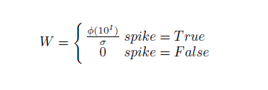
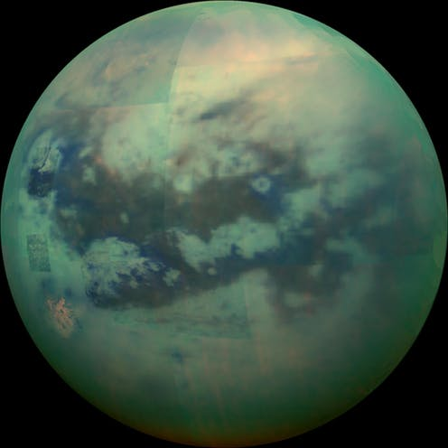
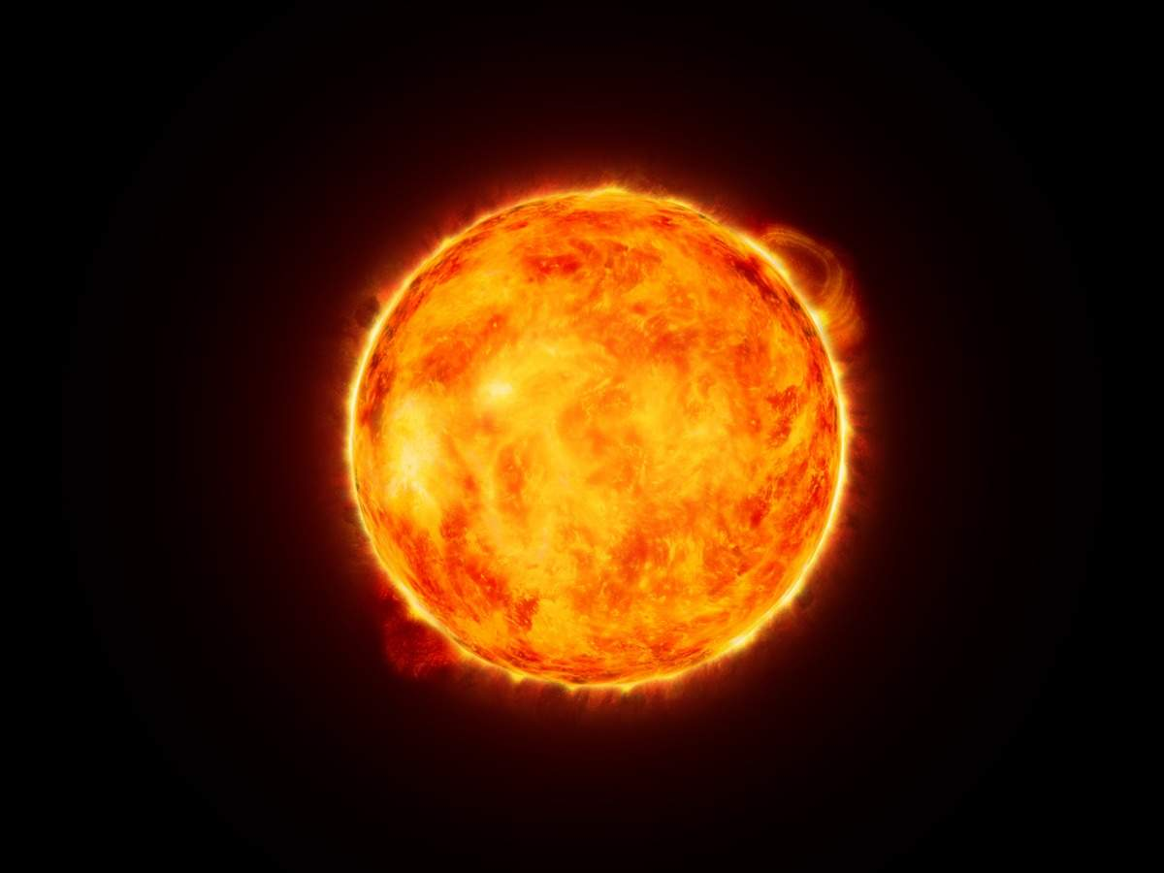
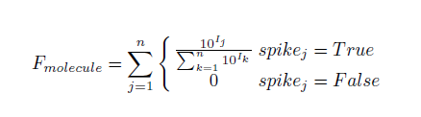
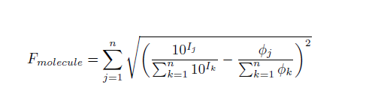

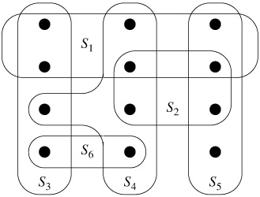
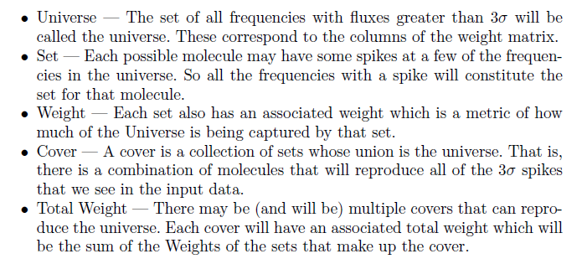
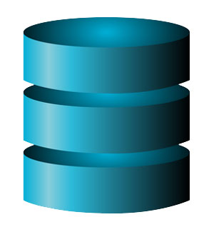
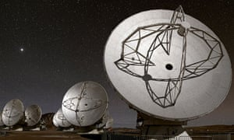


A Tutorial on How You Can Help The Human Race Find Our Next Home
Steven Cocke, Josephine McDaniel and Andrew Wilkins
Advisors: NASA - Conor Nixon, Ph.D and SMU - John Santerre, Ph.D
Master of Science in Data Science
Southern Methodist University, Dallas, TX 75275, USA
Introduction
Executive Summary & Results
Step 6
NASA Benefits
The primary objective of our work is to automate elemental and molecular classifications contained within planetary atmospheres using spectroscopic data obtained from the Atacama Large Millimeter/submillimeter Array (ALMA), but also to provide a means of detection for unknown molecules.
NASA Known Molecules
Our Results
$8,000 reoccurring cost savings
80 reocurring man-hours savings
Automated detection process through “plug n’ play’ Jupyter Notebook
Custome API to retrieve molecule information from multiple databases
An evaluation metric must be created to determine which molecule most likely is responsible for each 3-sigma spike in our window of data. This is passed on to the Set-Cover Algorithm
Cyanoacetylene
Methyl Cyanide
Ethyl Cyanide
Methyl Acetylene
???
Cyanoacetylene
Methyl Cyanide
Ethyl Cyanide
Methyl Acetylene
Formaldehyde
Weighting the Data
Step 1, 2 & 3
Light is emitted from the Sun to a planetary body. Light is reflected off of the planetary body’s atmosphere (Titan). The reflected light is observed from Earth via a telescope. In our case, the ALMA telescope located in Antofagasta, Chile.
Our model was able to correctly classify 100% of previously discovered molecules in Titan’s atmosphere, as well as identify other molecules that are most likely present.
Molecule Selection
Light
1.
Step 4
2.
Set-Cover Algorithm
Raw data is produced from the ALMA telescope, which includes flux and frequency. The 3 sigma-spikes are identified in the data.
Molecules Absorb/Reflect Light
Step 5 a)
The frequencies associated with three-sigma spikes are passed to Splatalogue to retrieve all molecules that could possibly contribute to those specific spikes.
ALMA
Telescope
3.
Data Enrichment
Data Prep
Raw Data
JPL
7.
6.
Step 5 b)
4.
5.
CDMS
Most
Probable
Molecule
Combination
Step 7
A custom API passes the molecule tags retrieved from Splatalogue to the JPL and CDMS databases, in order to retrieve all possible 3-sigma spikes for each molecule, over the span of all frequencies.
Splatalogue
The most probably molecules that make up the least-cost cover are found. These match the four NASA-known molecules on Titan, as well as suggest a fifth.
1

